Slide 1
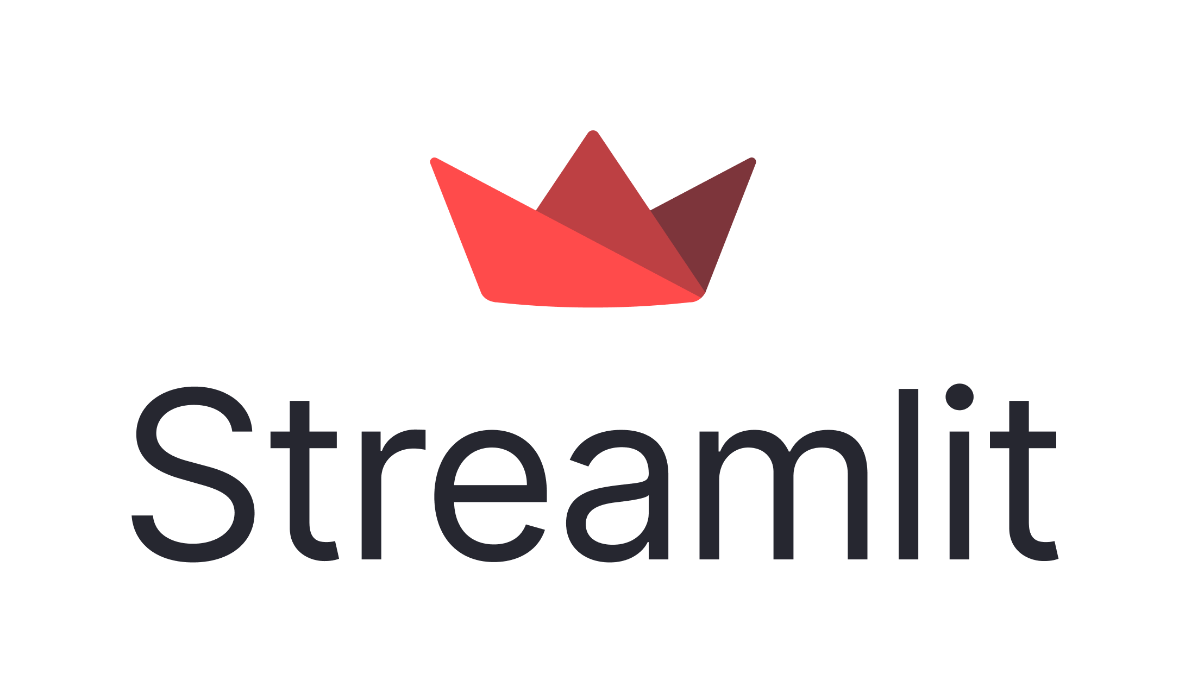
Oracle Cloud Generative AI Agents Demo
Customer Data Sources
Oracle Cloud Region
Internet
Oracle Services Network
VCN
Data Storage
Generative AI Agents Service
UI Application
Database
OCI Object
OpenSearch Knowledge Base
Managed Vector Store
Oracle Cloud Generative AI
Agent Endpoint
Virtual
User
Storage
Machine
Unstructured Data Sources

